Slide 1

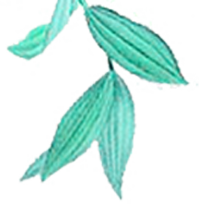

Welcome to Weifang
计算机213、214班
Team leader: 李浩宇 时金海
Team members: 陈金川 王子奎 刘 旭
郝务一 田宝亨 耿文正
姚征明 李慧文 李祚兵
徐昕宇 尹召璇 王呈陟

Slide 2
Contents
Humanistic customs
1
Culture
Natural scenery
2
3
Economics
4
5
Delicious food

Slide 3
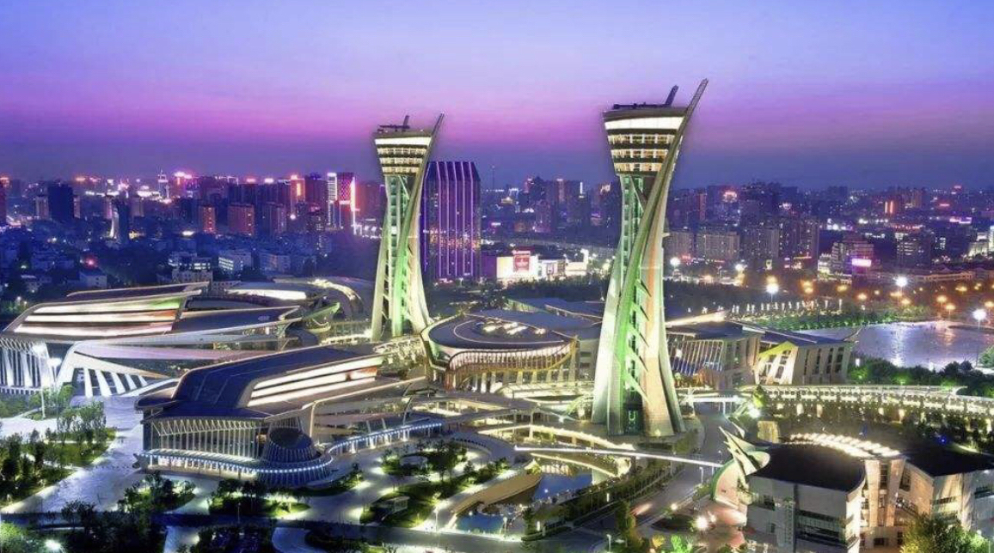
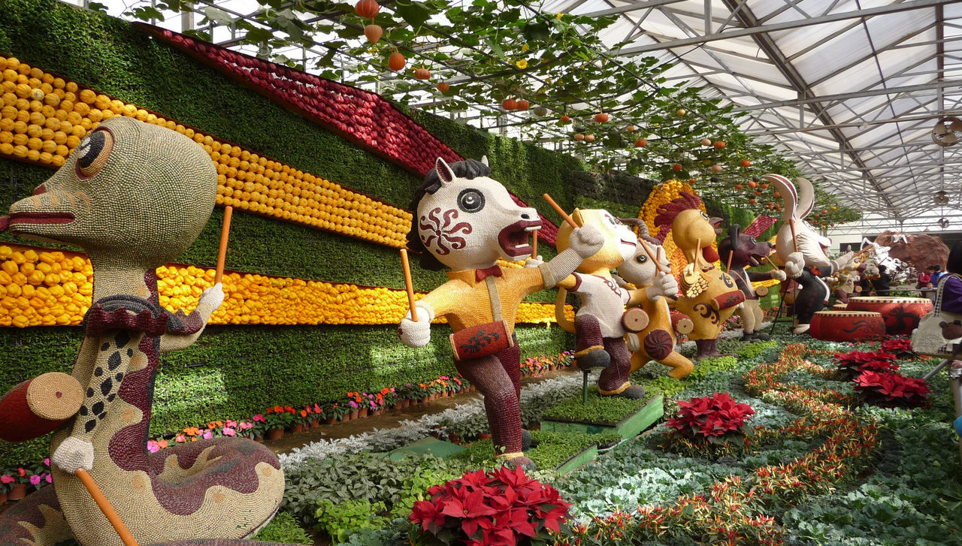
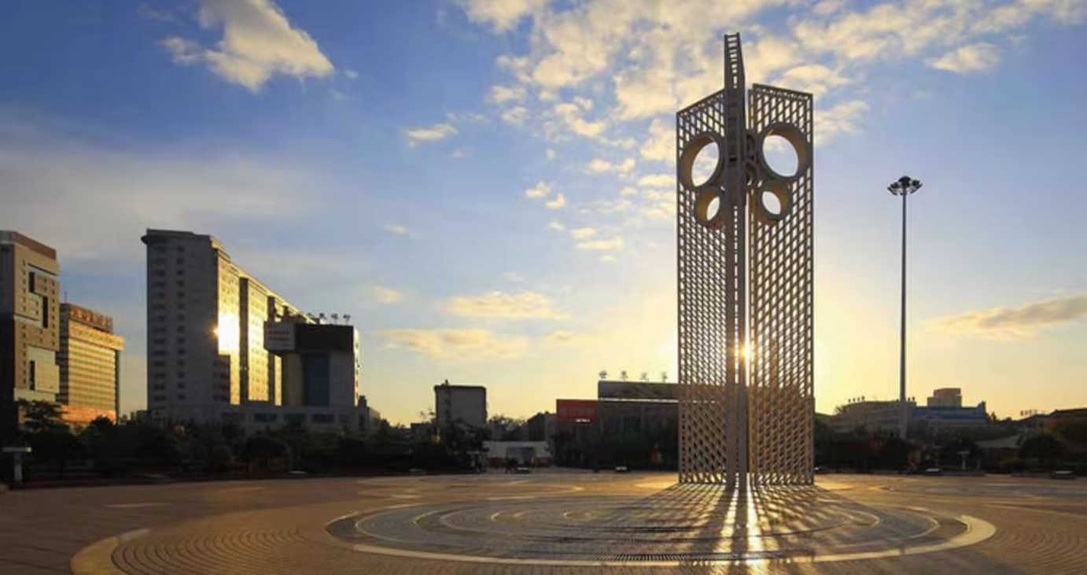
Kite Capital,Yuandu
My hometown is Weifang, a place known as the capital of kites, so Weifang is also called Kite Capital. Weifang was called "Weixian" in ancient times, also known as "Yuandu". It is located in the middle of Shandong Peninsula, the largest peninsula in China.The terrain is high in the South and low in the north and it has large areas of mountains and plains.It has twelve county and urban area.

Slide 4
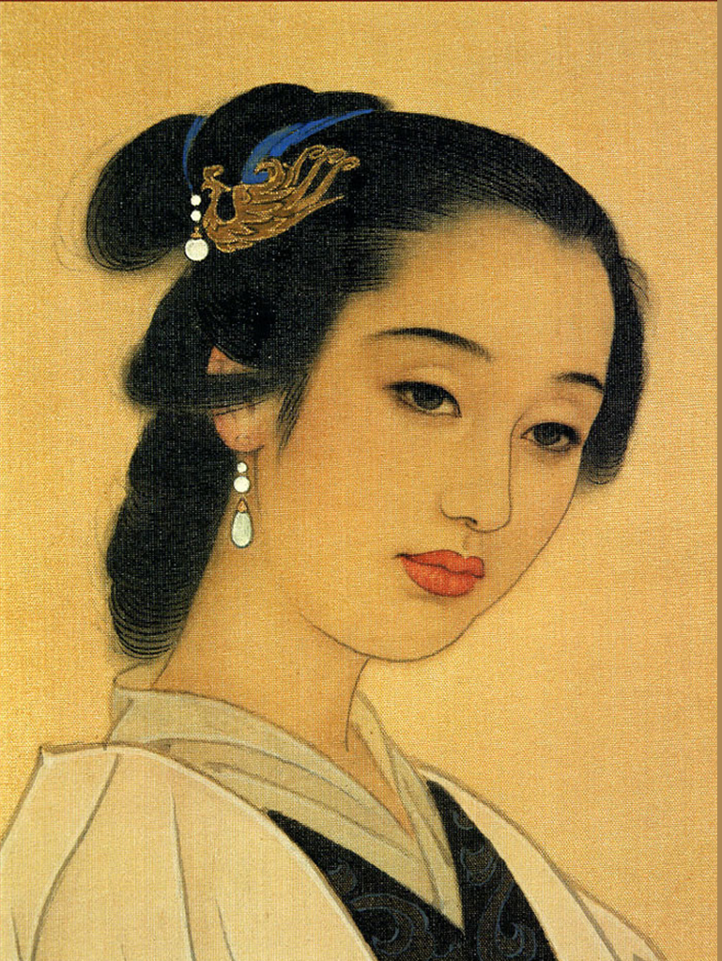
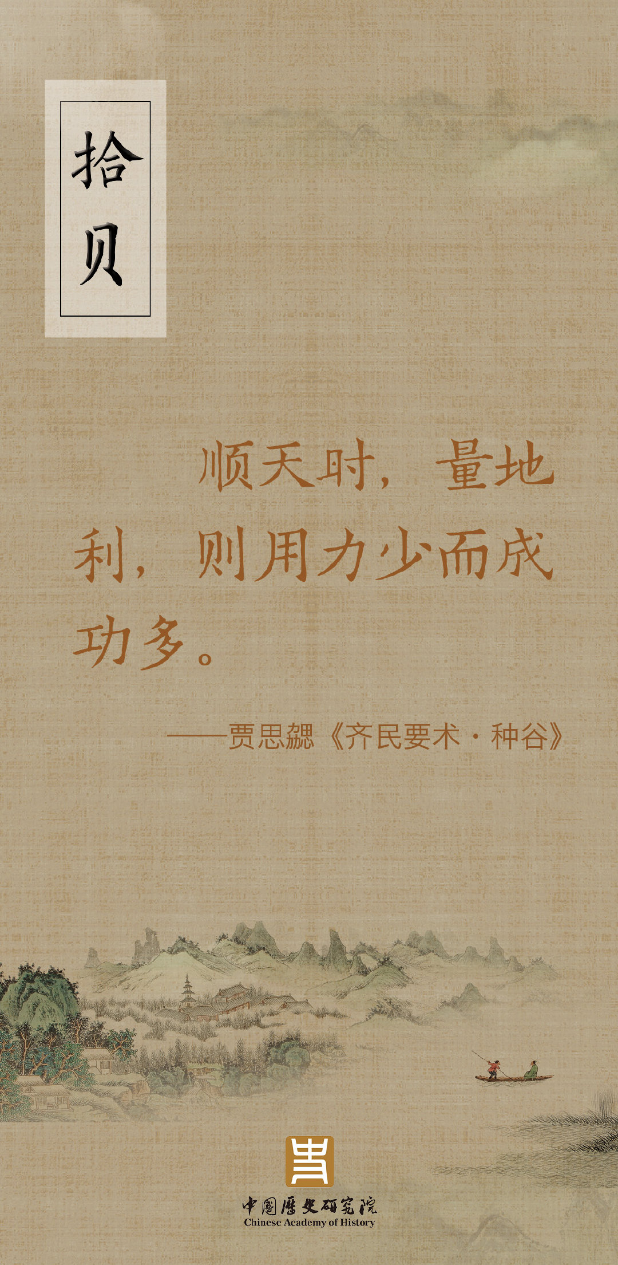
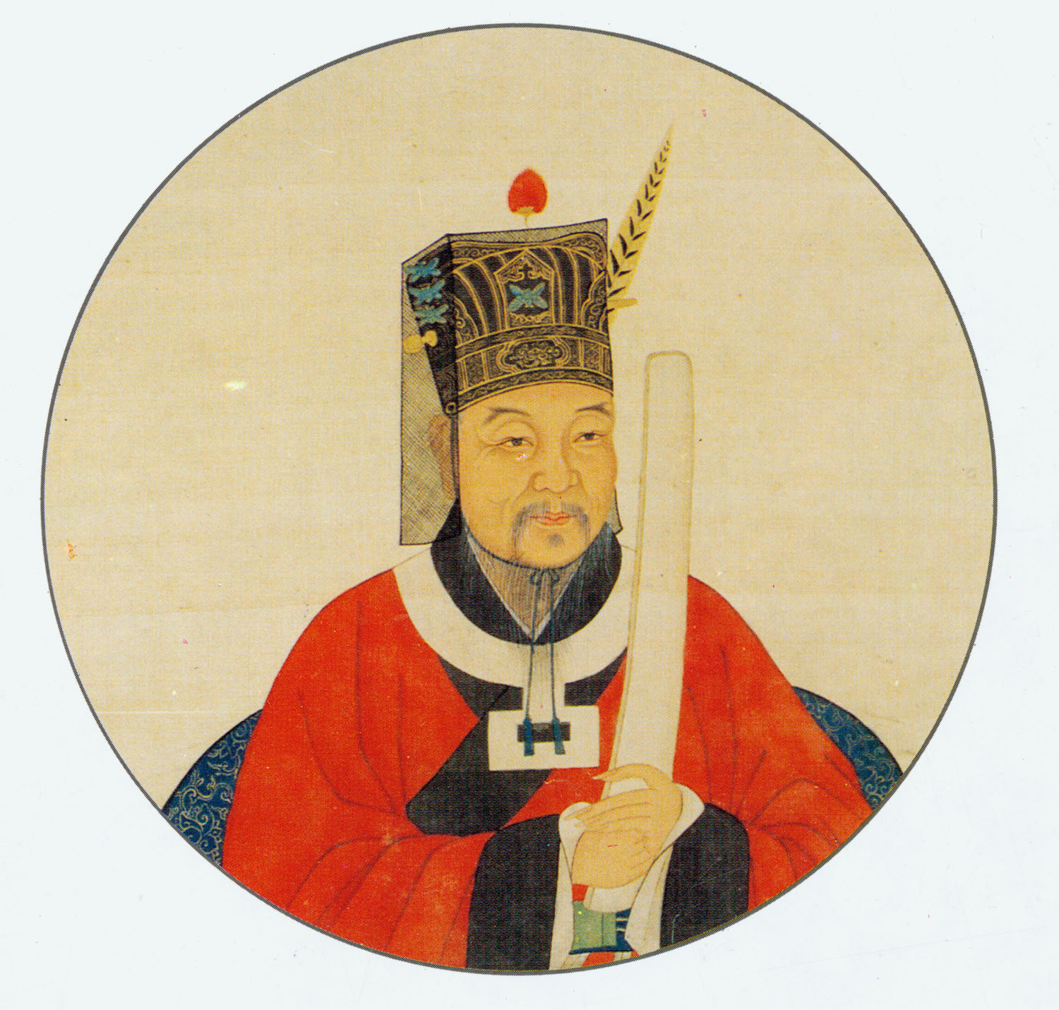
Humanistic customs
Weifang has a long history. There are many historical celebrities as well as lots of historical events in Weifang. Yan Ying, Jia Sixie, Fan Zhongyan, Li Qingzhao have lived here, Zang Kejia, Mo Yan also for our Weifang endorsement.

Slide 5
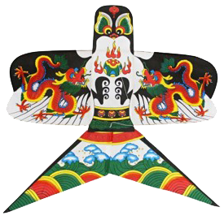
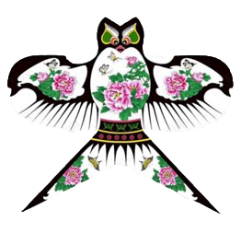
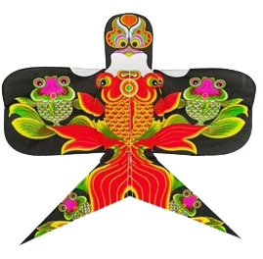
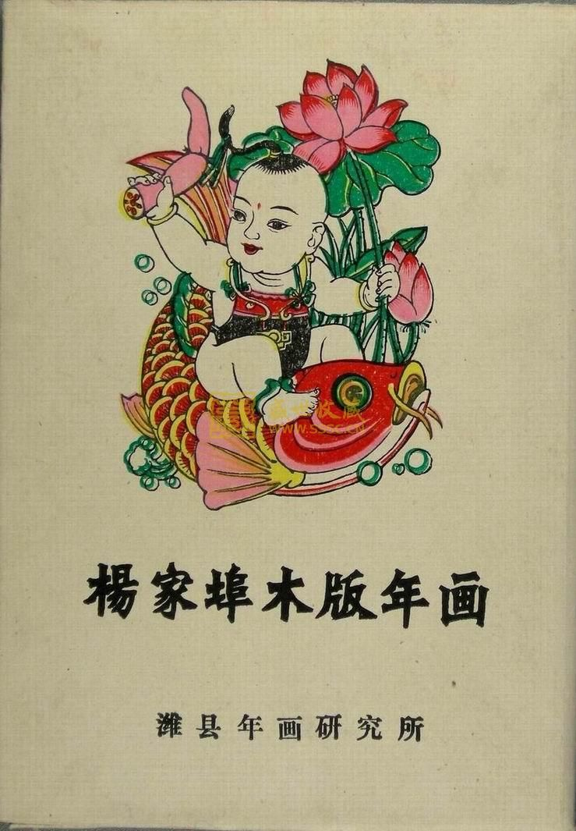
Culture
Weifang has a rich cultural heritage. Weifang is world-famous for kites and is called the kite capital because it is the birthplace of kites. At the same time, it is also the location of Yangjiabu woodcut New Year pictures, one of the three major New Year pictures.

Slide 6
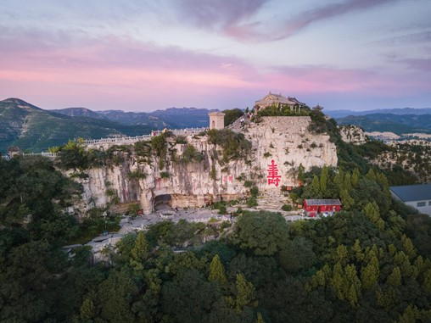
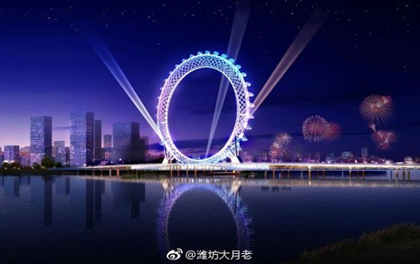
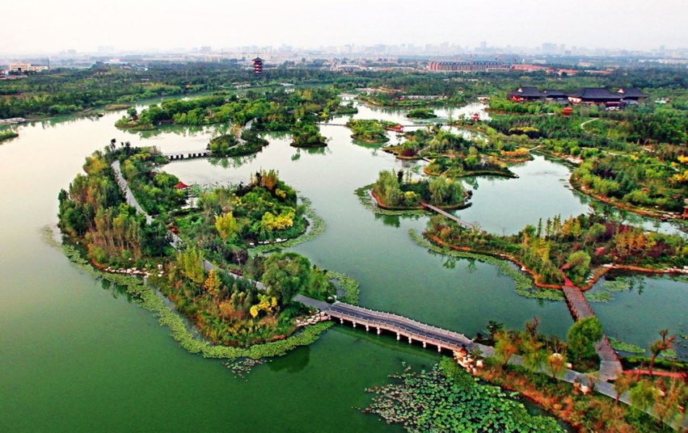
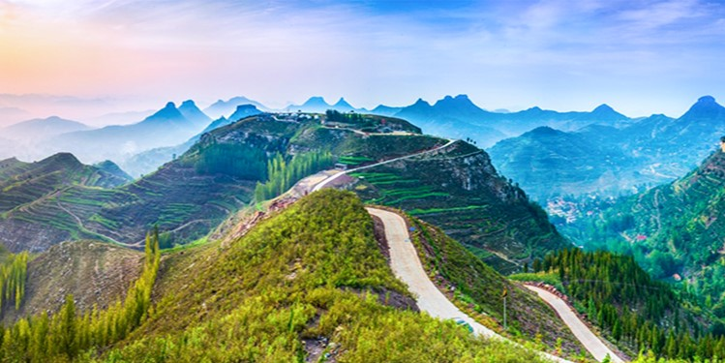
Natural scenery
Weifang, with its unique geographical location surrounded by mountains and rivers, borders Bohai Laizhou Bay in the north and Taiyi Mountains in the south, with picturesque scenic spots. Yimeng Mountain, Fuyan Mountain, Bailang River Wetland Park and other places are picturesque and linger.Ferris wheel, known as the Eye of Bohai Sea, is also located in Weifang. You can take it to look at the beautiful panorama of Bailang River.

Slide 7
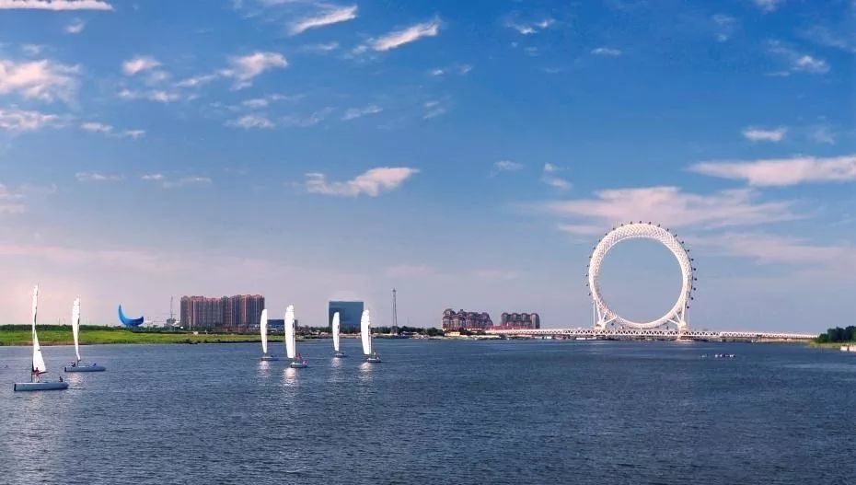
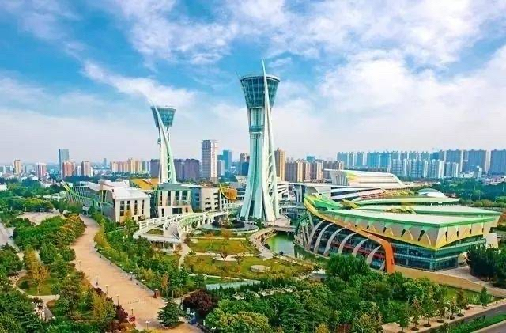
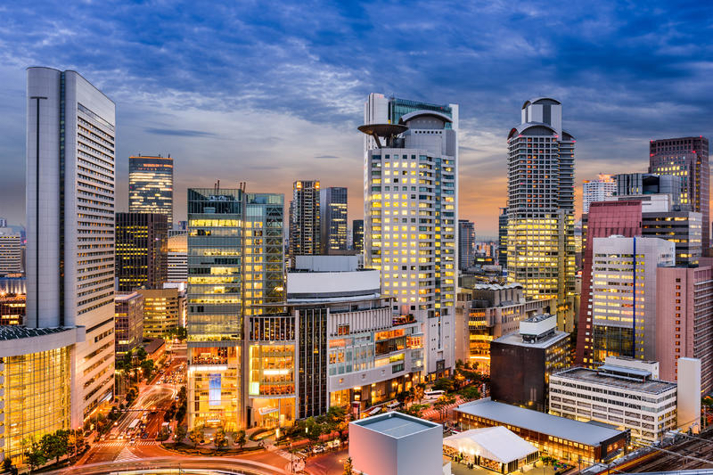
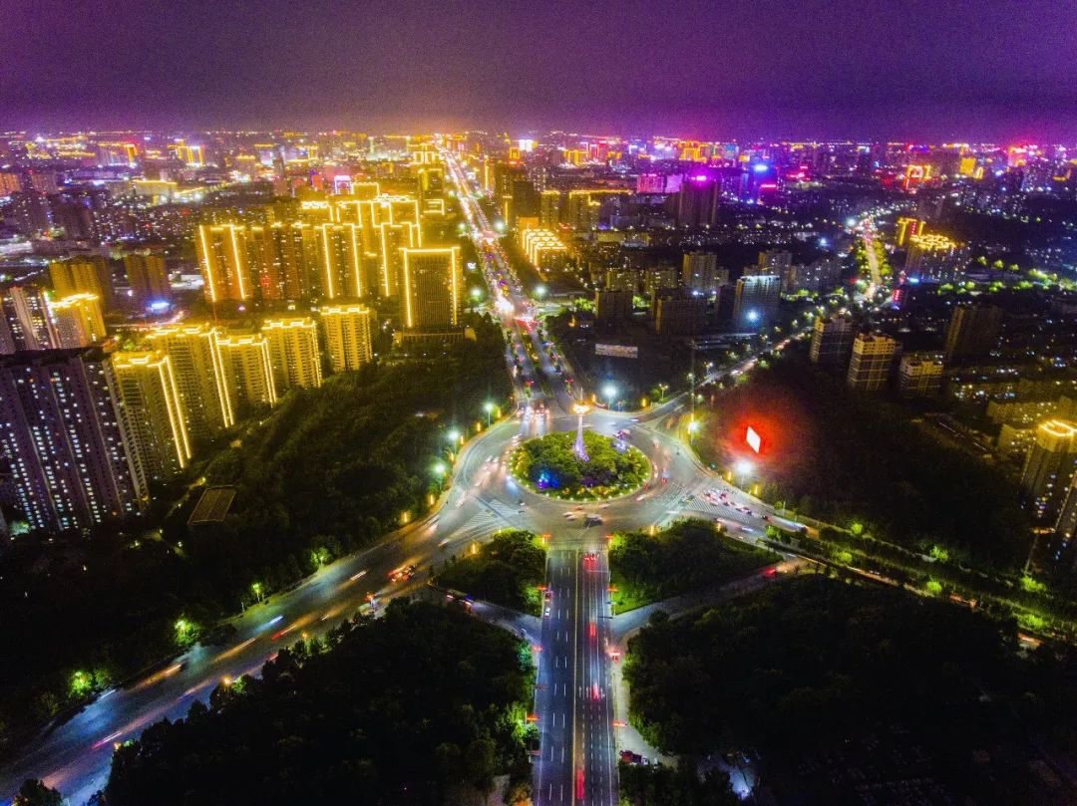
Economics
Weifang has strong comprehensive economic strength and ranks in the forefront among the 16 prefecture level cities in the province. Its regional GDP has already exceeded 550 billion. Its main economic industries are relatively developed, ranking among the top four in the province.

Slide 8
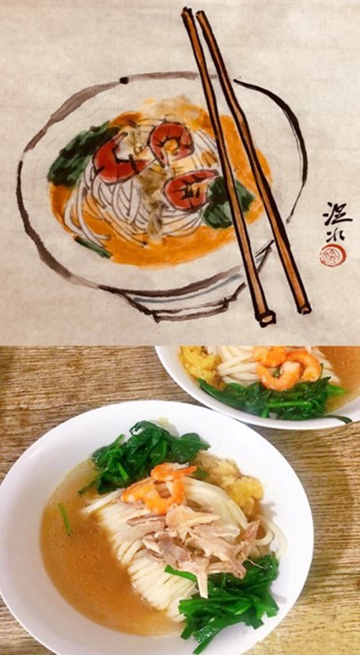
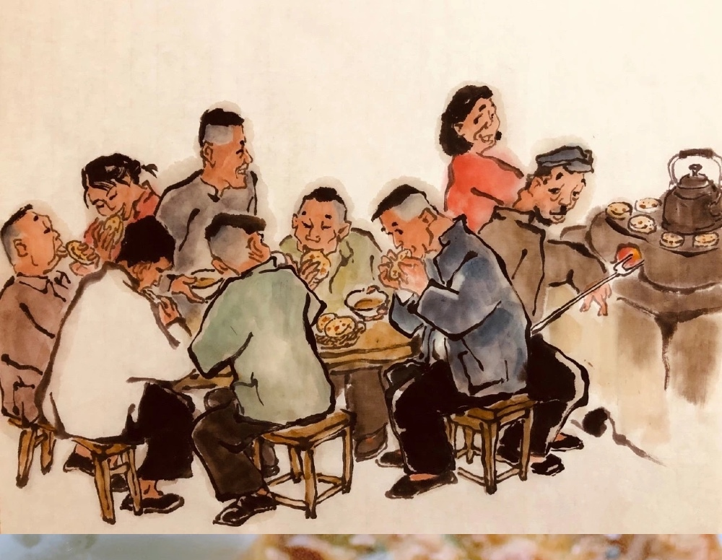
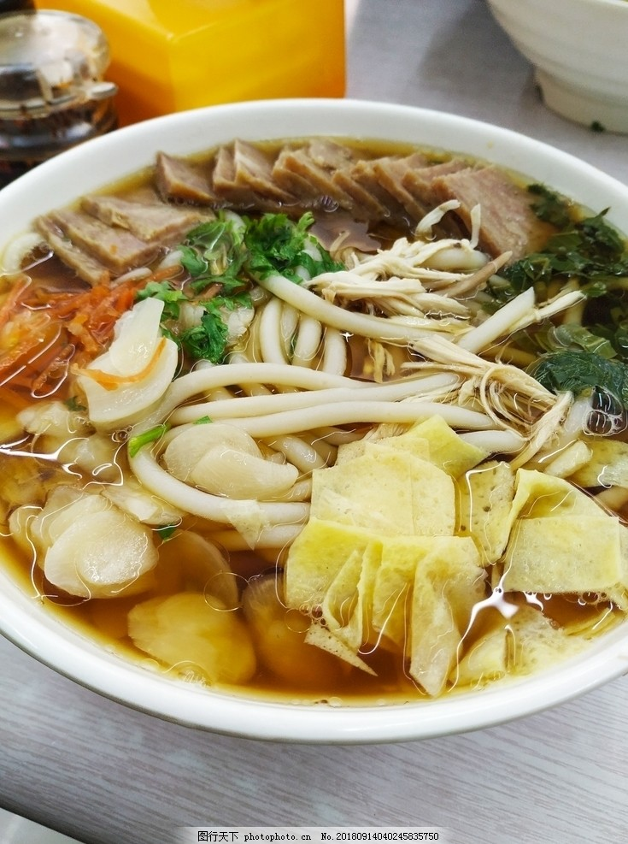
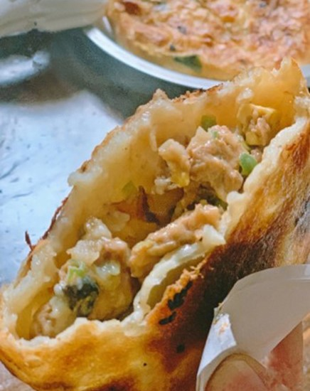
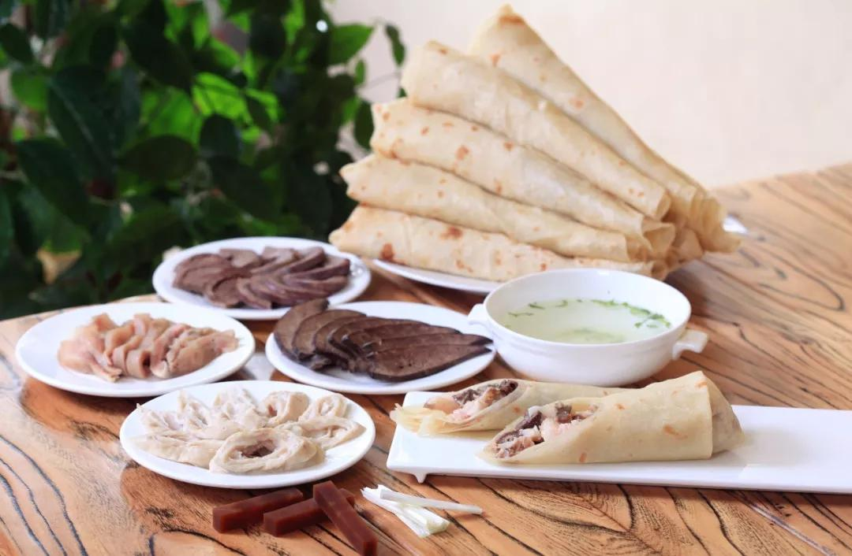
Delicious food
If delicacy is your favourite, Weifang is a great choice.Linqu whole sheep feast,Town God Temple baked wheaten cake and hele attract many travelers.

Slide 9
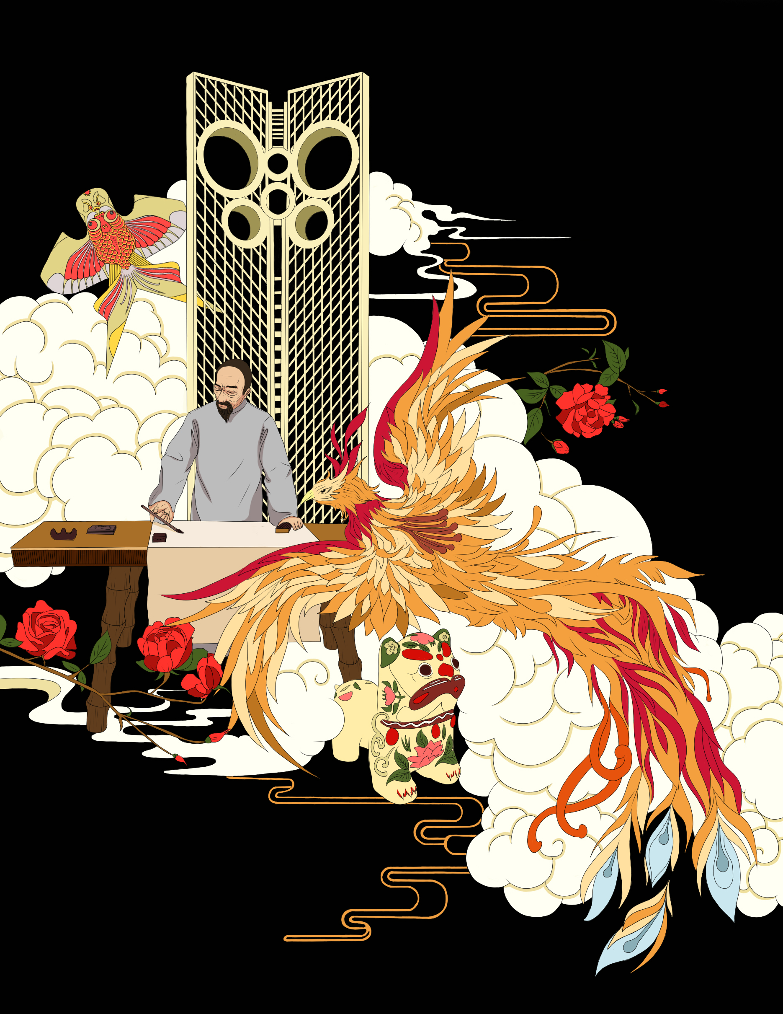
That's all ，thanks for you listening ！Welcome to Weifang!

